Slide 1
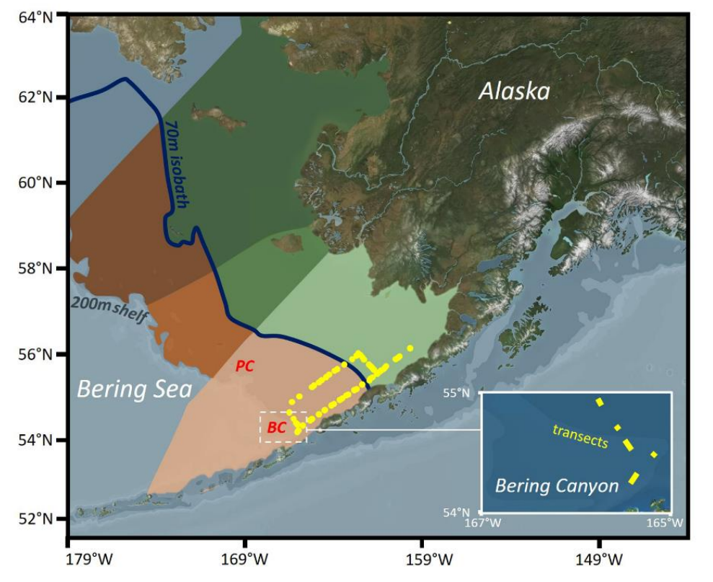
Proposed Regions:

Slide 2
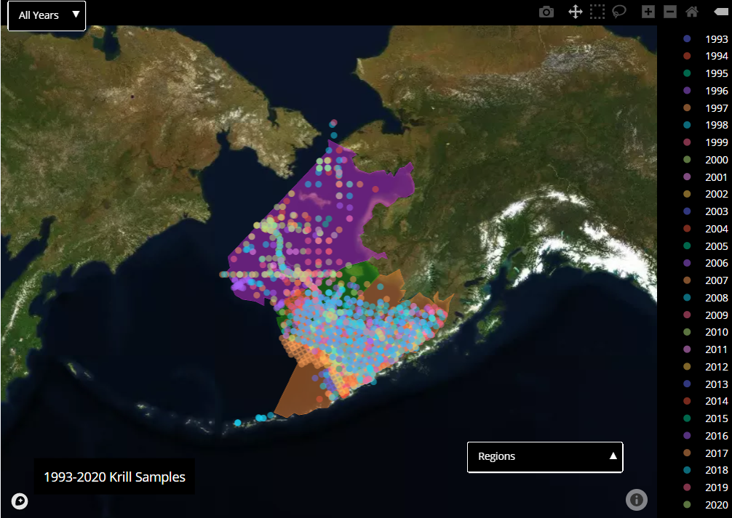
Statistically Realistic Regions:

Slide 3
Cold Pool
Sea Surface Temperature
Ocean Depth

Slide 4
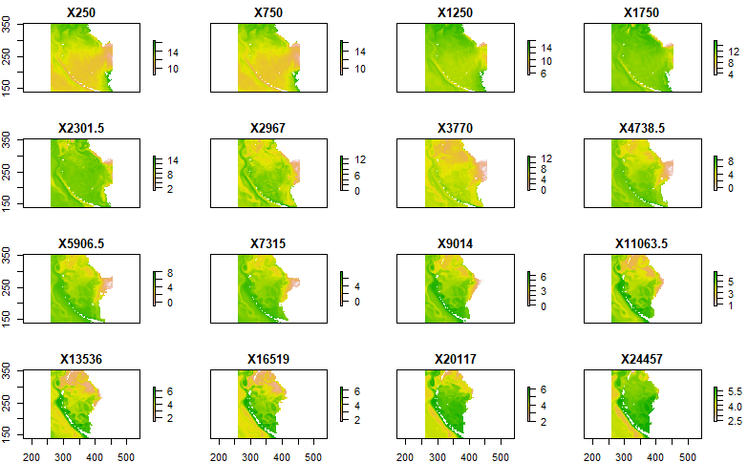
Circulation: Currents
At
Depth

Slide 5
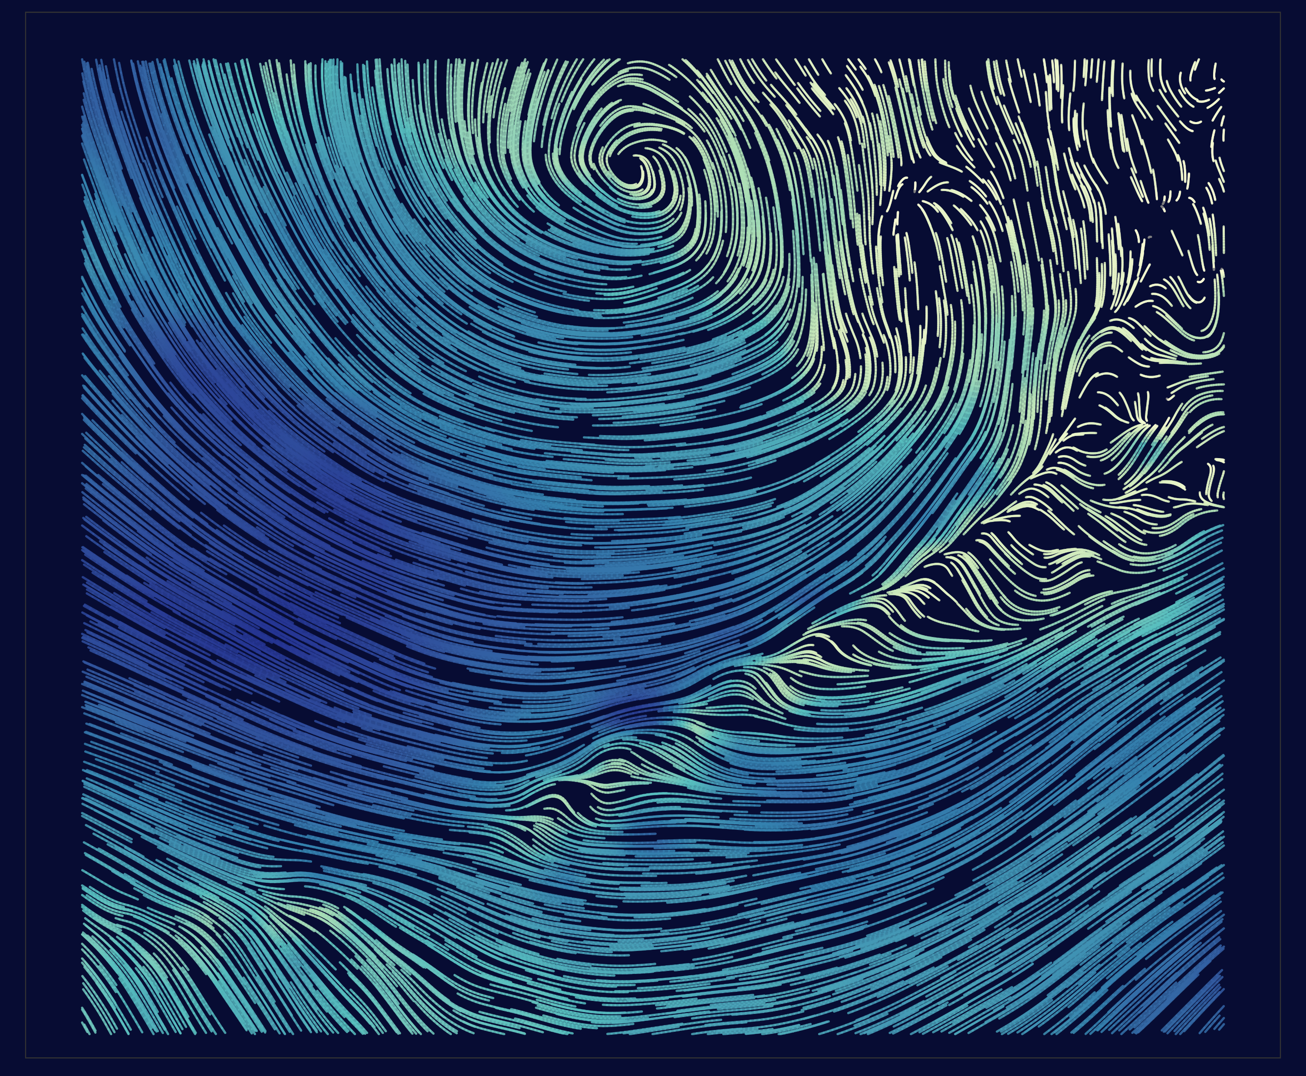
Circulation: Wind

Slide 6
Temporal changes: monthly (pictured) and annually (not shown)
Cold Pool
Sea Surface Temperature
Ocean Depth

Slide 7
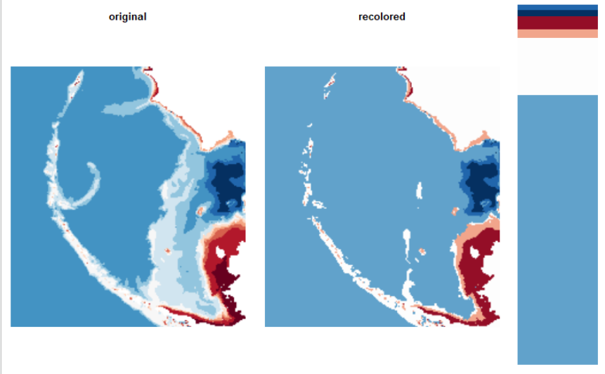
Bin all of the pixels into specified number of clusters per channel:

Slide 8
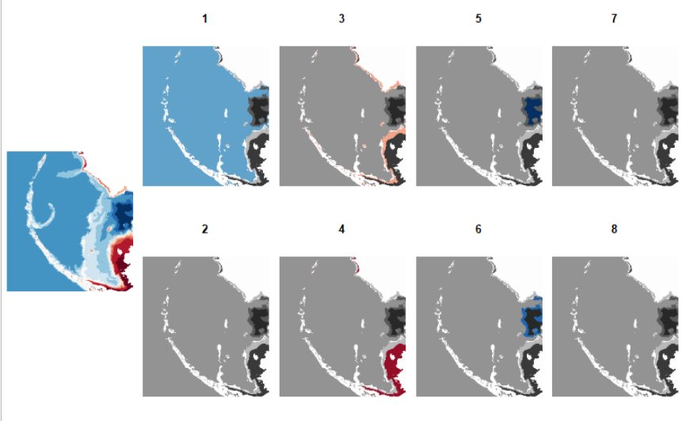
Re-cluster and divide patches per unit (ex: channel, color, threshold):

Slide 9
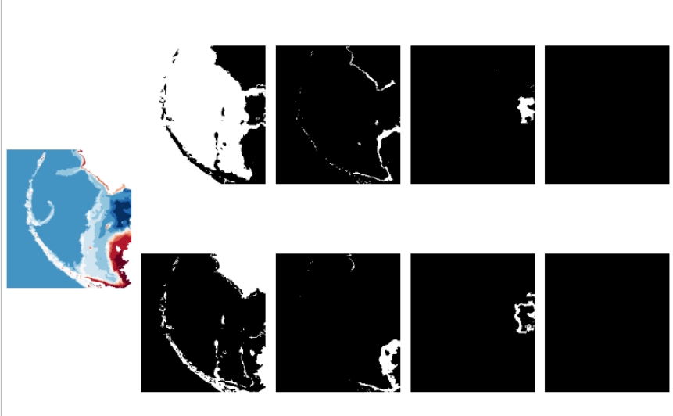
Separate color clusters into binary masks:

Slide 10


Polygons are now reproducible, and calculations or machine learning can begin:
Cold Pool Threshold
Nearby Diffusion

